Slide 1

IHS SOCIOLOGY MODULE

Slide 2
What is it to understand sociologically?
Katherine Mayo’s Mother India

Slide 3
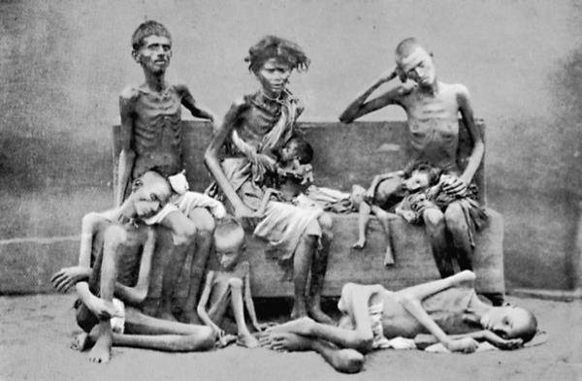
Seeing is not understanding!

Slide 4


Slide 5
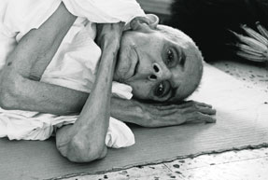

Slide 6
Peter Berger: The Art of Skepticism
It is not practice but an attempt to understand
Questioning the taken for granted

Slide 7
Sociological Aptitude:
Value-free: an intellectual training for controlling biases
Example of espionage: being the good spy!
‘looking behind scenes’/ ‘the art of mistrust’

Slide 8
According to Peter Berger: Sociologists occupy themselves with
The unofficial
Unrespectable—not only how law constructs criminals but how the criminal looks at law.
William Foote Whyte
matters that others regard as too sacred or as too distasteful for investigation

Slide 9
Debunk
Relativize
Leading to a cosmopolitan imagination—plurality of meaning. Sociologist must probe into layers of meaning and analyze how social reality is constructed.

Slide 10
It makes us see everyday things in a new light.
Not what you see, but how you see!

Slide 11
Peter Berger: An Invitation to Sociology

